Slide 1


FUTURE OF OPERATIONS

Slide 2



FUTURE OF OPERATIONS MANAGEMENT-Contents
Evolution Of Operation Management
Circular Economy
Industry 4.0
Notes:
CUSTOMER DIMENSION
SUATAINED PERFORMANCE
OPERATIONAL ADVANTAGE
STRATEGIC ADVANTAGE

Slide 3
Evolution Of Operations Management
8.AI/AR/VR
7.FMS/Robotics
6.CIM
5.CAD/CAM
4.Distributed Manufacturing
3.Computer Control Machines
2.Assembly Line
1.Traditional Manufacturing
Notes:
CUSTOMER DIMENSION
SUATAINED PERFORMANCE
OPERATIONAL ADVANTAGE
STRATEGIC ADVANTAGE

Slide 4
CIRCULAR ECONOMY
CIRCULAR ECONOMY:
REGENERATIVE AND RESTORATIVE BY DESIGN
Notes:
CUSTOMER DIMENSION
SUATAINED PERFORMANCE
OPERATIONAL ADVANTAGE
STRATEGIC ADVANTAGE

Slide 5
A REGENERATIVE ECONOMY
…keeping products, components and materials at their highest utility and value, at all times
…eliminating the concept of waste, with materials ultimately re-entering the economy at end of use as defined, valuable technical or biological nutrients
Notes:
CUSTOMER DIMENSION
SUATAINED PERFORMANCE
OPERATIONAL ADVANTAGE
STRATEGIC ADVANTAGE

Slide 6

RETHINKING VALUE CREATION-Three guiding principles to the circular economy
Preserve and enhance natural capital by controlling finite stocks and balancing renewable resource flows
Optimize resource yields by circulating products, components, and materials at the highest utility at all times in both technical and biological cycles.
Foster system effectiveness by revealing and designing out negative externalities.
Notes:
CUSTOMER DIMENSION
SUATAINED PERFORMANCE
OPERATIONAL ADVANTAGE
STRATEGIC ADVANTAGE

Slide 7
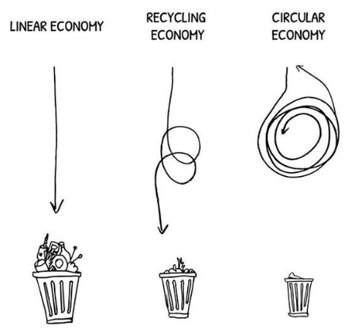
LINEAR ECONOMY AND CIRCULAR ECONOMY
Notes:
CUSTOMER DIMENSION
SUATAINED PERFORMANCE
OPERATIONAL ADVANTAGE
STRATEGIC ADVANTAGE

Slide 8
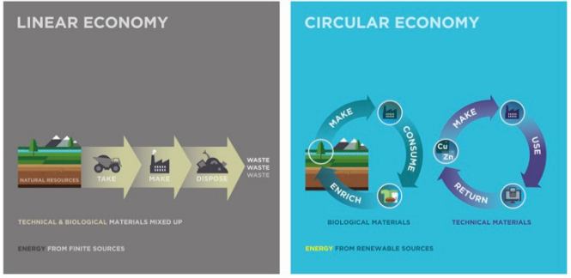
LINEAR ECONOMY AND CIRCULAR ECONOMY
Notes:
CUSTOMER DIMENSION
SUATAINED PERFORMANCE
OPERATIONAL ADVANTAGE
STRATEGIC ADVANTAGE

Slide 9
HOW DO PRODUCTION AND SERVICE OPERATIONS DISTURB THE ENVIRONMENT ?
How do production and service operations disturb the environment?
Unsustainable use of natural resources
Excess use of energy
Waste generation due to the process or its requirements
Discharge of Gaseous and liquid pollutants
Global warming
Ozone hole
Problem of solid waste
Nuclear waste and Radioactivity
Thermal pollution and noise pollution

Slide 10
HOW DO PRODUCTION AND SERVICE OPERATIONS DISTURB THE ENVIRONMENT ?
Design of wasteful products
Spreading of Monoculture
Enhancing Customer Wants
Choice of Environmental Unfriendly systems, Processes and Products
Notes:
IPHONE
LOREL
COKE , colour, size
SIZE COLOUR
VITUAL DESIGN PROTOTYPE
Repositioning- hutch-Vodafone, godrej, apple, uti-axis bank.

Slide 11
GREEN PROCESSES AND GREEN PRODUCTION
Making the processes green:-
Increase resource productivity
Reduce
Reuse
Lean Production/Green Production
Eliminate waste products
Recycle the waste
Treat the waste before it is released into the environment
Ecological footprints
Keep on improving the waste disposal methods

Slide 12
GREEN PROCESSES AND GREEN PRODUCTION
Cleaner production, Non-waste technology and Industrial Ecology
Replace the hazardous processes

Slide 13
LIFE CYCLE OF GREEN PRODUCT/SERVICES
In the lifecycle of green product/service main focus is given during the following stages:
Design
Supply Chain
Reverse Supply Chain

Slide 14
ORGANISATIONAL RESPONSE TO ENVIRONMENTAL SUSTAINABILITY
Organisational response to environmental sustainability
Green Operations as competitive strategy
Compliance to government controls
Voluntary Actions

Slide 15
E-PRINCILPES AND R-ACTIONS OF CIRCULAR ECONOMY
E- principles and R-actions
The guiding principles are Efficiency, Economics, Empowerment, Excellence and Environment
The R- actions are
Reduce
Reuse
Recycle
Replace
Reform-the process and design
Refuse- business and firms to the ecology
Relocate-if firms are damaging the surrounding

Slide 16
INDUSTRY 4.0

Slide 17
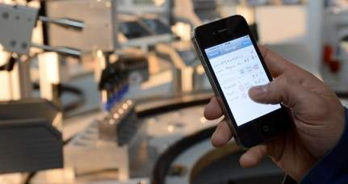
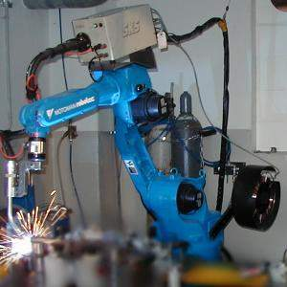
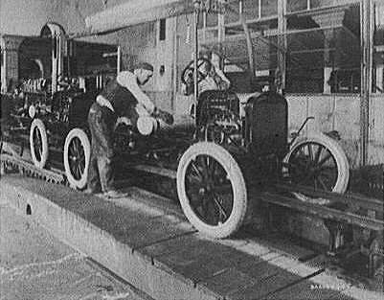
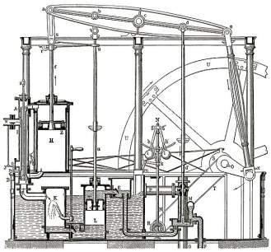
Industrial Evolution
4. Industrial revolution
Based on cyber-physical-
systems
3. Industrial revolution
Through the use of electronics
and IT further progression in
autonomous production
2. Industrial revolution
Introducing mass production
lines powered by electric
energy
Level of complexity
1. Industrial revolution
Introducing mechanical
production machines powered
by water and steam
Industry 1.0
Industry 2.0
Industry 3.0
Industry 4.0
End of the
18th century.
Beginning of the
20th century
Beginning of the
70th
Today
Source: DFKI/Bauer IAO

Slide 18
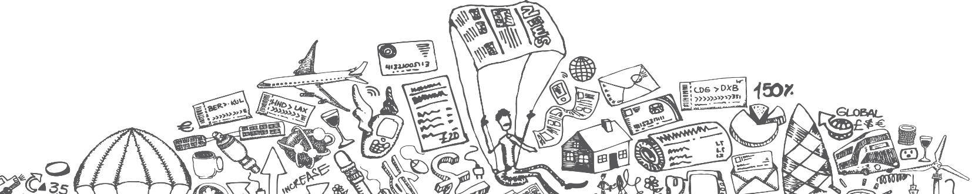
Phases of earlier 3 Industrial Revolutions
1760 to 1840 - Ushered in Mechanical production; railways and steam engine
1870 to 1940 - Mass production; electricity and assembly line
1960 to 2010 - Computers; semi conductors, main frame computing, personal devices, internet
Notes:
It is possible to apply this template to exiting presentations.
Have the latest presentation template open
Click on the View tab and select Normal
Delete all unwanted slides
Click on the Insert tab from the menu bar and select Slides from Files
Click on Browse. Navigate to the presentation you wish to update with the new template. Highlight the presentation and click Open
Wait for the slides from the presentation to load and click on Insert All. Then click Close
Check the inserted slides to ensure that the most appropriate master slide has been used on each slide
To change the master applied to a slide select the slide you wish to apply a different master to then click on the Format tab from the menu bar and select Slide Design
From the Used in This Presentation section choose the master you wish to apply to the slide and hover over it to reveal a drop-down arrow. Click on the arrow and select Apply to Selected Slides
It is important to thoroughly check the presentation to ensure that no further formatting is needed.

Slide 19
Introduction to Industry 4.0
It is current trend of automation and data exchange in manufacturing technologies.
It enables a company to achieve operational excellence by utilizing resources to the maximum level.
Big data analytics will help early detection of defects and production failures, thus enabling their prevention hence increases productivity, & quality.

Slide 20
Did not exist in 2006
p
iPhone
iPad
Kindle
4G
Uber
Airbnb
Android

Slide 21
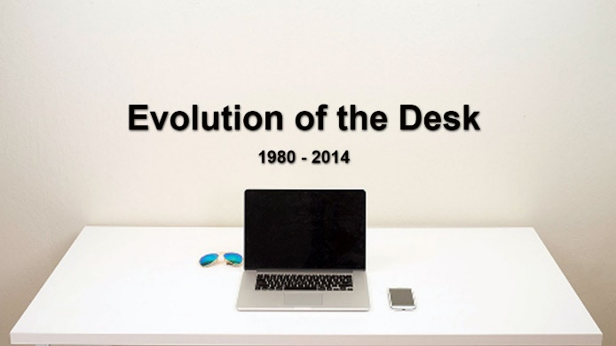
Time to reach 100 Million customers
Telephone 75 Years
Web 7 Years
Facebook 4 Years
Instagram 2 Years
Pokemon Go 1 Month

Slide 22
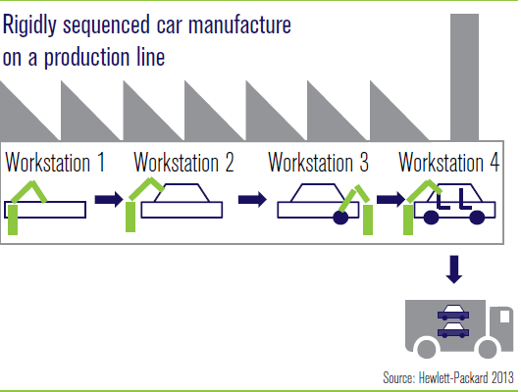
Today’s Factory

Slide 23
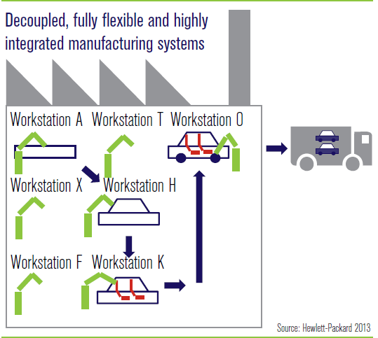
Tomorrow’s Factory

Slide 24
Industry 4.0
Six Design Principles
Interoperability: the ability of cyber-physical systems (i.e. work piece carriers, assembly stations and products), humans and Smart Factories to connect and communicate with each other via the Internet of Things and the Internet of Services
Virtualization: a virtual copy of the Smart Factory which is created by linking sensor data (from monitoring physical processes) with virtual plant models and simulation models
Decentralization: the ability of cyber-physical systems within Smart Factories to make decisions on their own
Real-Time Capability: the capability to collect and analyze data and provide the insights immediately
Service Orientation: offering of services (of cyber-physical systems, humans and Smart Factories) via the Internet of Services
Modularity: flexible adaptation of Smart Factories for changing requirements of individual modules

Slide 25
Building blocks of Industry 4.0
Industry 4.0
Autonomous Robots
Simulation
Horizontal and vertical system integration
Additive Mfg
Industrial Internet of Things + Sensors
Augmented reality
Big data analytics
Cyber Security

Slide 26
Examples
SIEMENS
German manufacturing giant Siemens, an industrial user, is implementing an Industry 4.0 solution in medical engineering. For years, artificial knee and hip joints were standardized products, with engineers needing several days to customize them for patients. Now, new software and steering solutions enable Siemens to produce an implant within 3 to 4 hours.

Slide 27
Impact
Business
Customer expectations
Data enhanced products
Collaborative innovation
New operating models
Combining digital, physical and biological worlds
Notes:
It is possible to apply this template to exiting presentations.
Have the latest presentation template open
Click on the View tab and select Normal
Delete all unwanted slides
Click on the Insert tab from the menu bar and select Slides from Files
Click on Browse. Navigate to the presentation you wish to update with the new template. Highlight the presentation and click Open
Wait for the slides from the presentation to load and click on Insert All. Then click Close
Check the inserted slides to ensure that the most appropriate master slide has been used on each slide
To change the master applied to a slide select the slide you wish to apply a different master to then click on the Format tab from the menu bar and select Slide Design
From the Used in This Presentation section choose the master you wish to apply to the slide and hover over it to reveal a drop-down arrow. Click on the arrow and select Apply to Selected Slides
It is important to thoroughly check the presentation to ensure that no further formatting is needed.

Slide 28
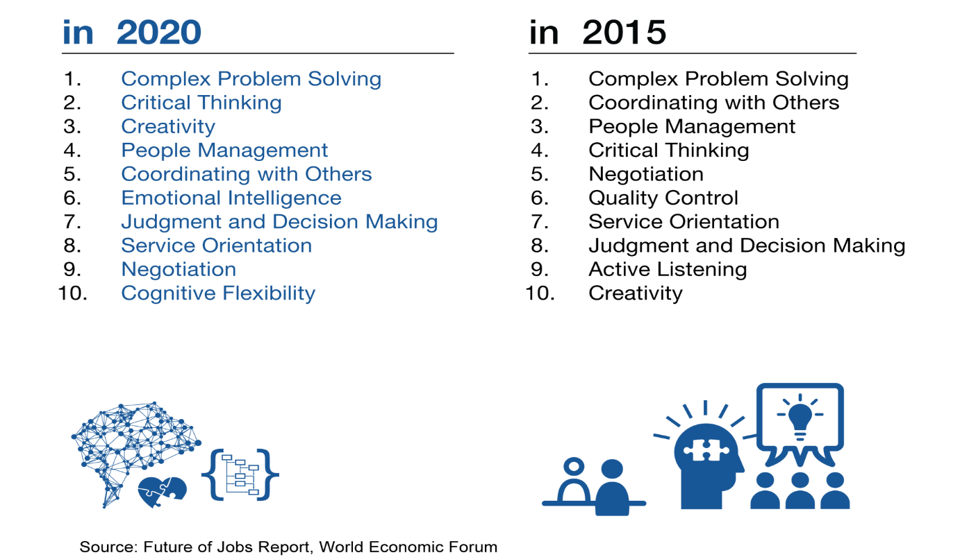
Top 10 Skills to be relevant in Industry 4.0

Slide 29
THANK YOU.

