Slide 1


FACILITIES LOCATION

Slide 2
PLANT LOCATION
PLANT LOCATION IS THE FUNCTION OF DETERMINING LOCATION FOR A PLANT FOR MAXIMUM OPERATING ECONOMY AND EFFECTIVENESS.

Slide 3
NEED FOR LOCATION SELECTION
BUSINESS NEWLY STARTED.
EXISTING BUSINESS HAS OUTGROWN AND EXPANSION NOT POSSIBLE.
MARKET NECESSITATES THE ESTABLISHMENT OF BRANCHES.
A LEASE EXPIRES
POSSIBILITY OF REDUCING MANUFACTURING COST BY SHIFTING
OTHER SOCIAL OR ECONOMIC REASONS, FOR EX, INADEQUATE LABOUR SUPPLY, SHIFTING OF THE MARKET ETC.

Slide 4
NEED FOR LOCATION SELECTION
FACTORS PROMOTING GLOBALISATION OF OPERATIONS
REGULATORY & ECONOMIC REFORMS
FACTOR COST ADVANTAGES
EXPANDING MARKETS IN DEVELOPING COUNTRIES
LOCATION ISSUES HAVE BECOME MORE PROMINENT IN RECENT YEARS DUE TO GLOBALISATION
LOCATION DECISION PERTAINS TO THE CHOICE OF APPROPRIATE GEOGRAPHICAL SITE FOR LOCATING MANUFACTURING & SERVICE FACILITIES OF AN ORGANISATION

Slide 5
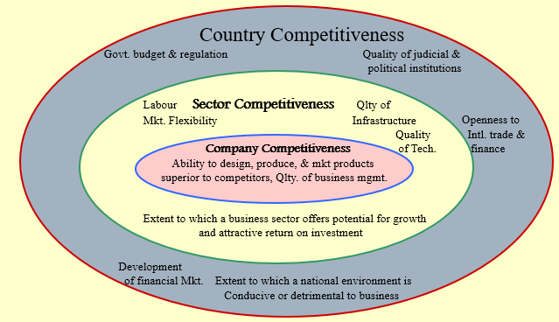
COMPETITIVENESS OF A LOCATION : THREE TIER MODEL

Slide 6
STEPS IN LOCATION SELECTION
TO BE SYSTEMATIC, IN CHOOSING A PLANT LOCATION, THE ENTREPRENEUR WOULD DO WELL TO PROCEED STEP BY STEP, THE STEPS BEING,
WITHIN THE COUNTRY OR OUTSIDE
SELECTION OF THE REGION
SELECTION OF THE LOCALITY OR COMMUNITY
SELECTION OF THE EXACT SITE

Slide 7
STEPS IN LOCATION SELECTION
WITH IN COUNTRY OR OUTSIDE
POLITICAL STABILITY
EXPORT AND IMPORT REGULATIONS
CURRENCY AND EXCHANGE RATES
CULTURAL AND ECONOMIC PECULIARITIES
NATURAL OR PHYSICAL ENVIRONMENT

Slide 8
STEPS IN LOCATION SELECTION
SELECTION OF REGION
AVAILABILITY OF RAW MATERIAL
NEARNESS TO THE MARKET
AVAILABILITY OF POWER
TRANSPORT FACILITY
SUITABILITY OF CLIMATE
GOVERNMENT POLICY
COMPETITION BETWEEN STATE

Slide 9
STEPS IN LOCATION SELECTION : SELECTION OF COMMUNITY
AVAILABILITY OF LABOR
CIVIC AMENITIES FOR WORKERS
EXISTENCE OF COMPLEMENTARY AND COMPETING INDUSTRIES
FINANCE & RESEARCH FACILITY
AVAILABILITY OF WATER & FIRE FIGHTING FACILITIES
LOCAL TAXES & RESTRICTION
MOMENTUM OF AN EARLY START
PERSONAL FACTORS

Slide 10
STEPS IN LOCATION SELECTION
SELECTION OF SITE
SOIL, SIZE AND TOPOGRAPHY
DISPOSAL OF WASTE

Slide 11
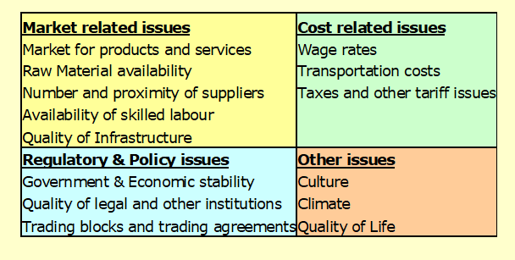
LOCATION DECISION : RELEVANT FACTORS

Slide 12
OTHER ISSUES IN LOCATION PLANNING
GEO-POLITICAL FACTORS…EXAMPLE…TATA NANO CAR.. SINGUR TO GUJARAT
THESE DEVELOPMENTS POINT TO TWO AREAS WHICH COULD AFFECT THE LOCATION PLANNING PROBLEM VERY SIGNIFICANTLY
AVAILABILITY OF GOOD TRANSPORTATION INFRASTRUCTURE
USE OF INTERNET AND IT INFRASTRUCTURE
LOCATION PLANNING IN THE OVERALL CONTEXT OF JUST-IN-TIME MANUFACTURING PHILOSOPHY (SUPPLIERS LOCATED IN THE VICINITY (20 – 40 KM RADIUS) OF THE MANUFACTURER)‏
SERVICE QUALITY DEPENDS ON RESPONSIVENESS OF SERVICE DELIVERY SYSTEM. LOCATING SERVICE OUTLETS, CLOSE TO THE DEMAND POINT IS AN IMPORTANT REQUIREMENT IN A SERVICE SYSTEM

Slide 13
FACILITY/PLANT LOCATION – GOVT POLICY – SPECIAL ZONES FOR LOCATION
UNDER OPERATION : SANTACRUZ, KANDLA, COCHIN, NOIDA, FALTA, CHENNAI, VISAKHAPATNAM
ZONES UNDER DEVELOPMENT : KANPUR, GREATER NOIDA, BHADOHI, PARADEEP, GOPALPUR, KULPI, INDORE, HASSAN, KAKINADA, DRONAGIRI, POSITRA, NANGUNERI

Slide 14
FACILITY LOCATION MODELS
ALFRED WEBER”S FORMULA
RATIO OF RAW MATERIAL WEIGHT/FINISHED PRODUCT = ?
A) IF THE RATIO > 1, LOCATE THE PLANT NEAR THE SOURCE OF RAW MATERIAL.
B) OR ELSE , EVALUATE OTHER FACTORS LIKE LABOUR, MARKET.
CENTER OF GRAVITY METHOD

Slide 15
FACILITY LOCATION MODELS
FACTOR RATING METHOD
POINT RATING METHOD
BREAK EVEN ANALYSIS
QUALITATIVE FACTOR ANALYSIS

Slide 16
LOCATION FACTOR RATING METHOD : STEPS
IDENTIFY AND LIST DOWN ALL THE RELEVANT FACTORS FOR THE LOCATION DECISION.
ESTABLISH THE RELATIVE IMPORTANCE OF EACH FACTOR IN THE FINAL DECISION.
RATE THE PERFORMANCE OF EACH CANDIDATE LOCATION USING A RATING MECHANISM.
COMPUTE A TOTAL SCORE FOR EACH LOCATION BASED ON ITS PERFORMANCE AGAINST EACH FACTOR AND RANK THEM IN THE DECREASING ORDER

Slide 17
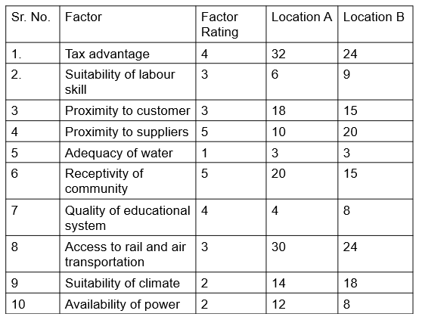
FACTOR RATING METHOD

Slide 18
CENTER OF GRAVITY METHOD
THE CENTER OF GRAVITY METHOD IS USED FOR LOCATING CENTRAL FACILITIES THAT CONSIDERS EXISTING FACILITIES, THE DISTANCES BETWEEN THEM, AND THE VOLUMES OF GOODS TO BE SHIPPED BETWEEN THEM.
THIS METHODOLOGY INVOLVES FORMULAS USED TO COMPUTE THE COORDINATES OF THE TWO-DIMENSIONAL POINT THAT MEETS THE DISTANCE AND VOLUME CRITERIA STATED ABOVE.
ALL THE DEMAND POINTS (OR THE SUPPLY POINTS, IF RAW MATERIAL IS SUPPLIED FROM SEVERAL LOCATIONS) ARE REPRESENTED IN A CARTESIAN COORDINATE SYSTEM.

Slide 19
CENTER OF GRAVITY METHOD
EACH DEMAND (OR THE SUPPLY POINT) WILL ALSO HAVE WEIGHT INDICATING THE QUANTUM OF SHIPMENT.
THEREFORE IT IS POSSIBLE TO IDENTIFY THE CENTRE OF GRAVITY OF THE VARIOUS DEMAND (OR SUPPLY) POINTS.

Slide 20
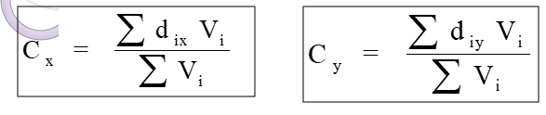
CENTER OF GRAVITY METHOD FORMULA
Cx = X coordinate of center of gravity
Cy = Y coordinate of center of gravity
dix = X coordinate of the ith location
diy = Y coordinate of the ith location
Vi = volume of goods moved to or from ith
location

Slide 21
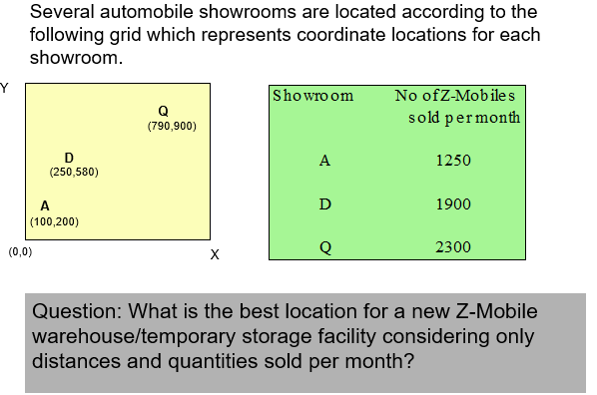
EXAMPLE OF CENTER OF GRAVITY METHOD

Slide 22
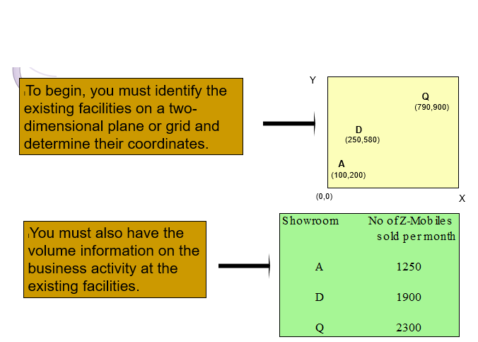
EXAMPLE OF CENTER OF GRAVITY METHOD

Slide 23
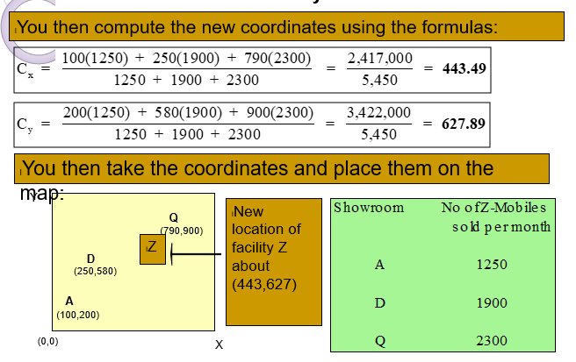
EXAMPLE OF CENTER OF GRAVITY METHOD

Slide 24
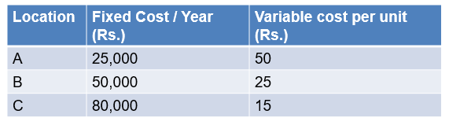
BREAK EVEN ANALYSIS - EXAMPLE
Potential locations A, B and C have the cost structures shown for producing a product expected to sell at Rs. 100 per unit. Find the most economical location for an expected volume of 2,000 units / year.

Slide 25
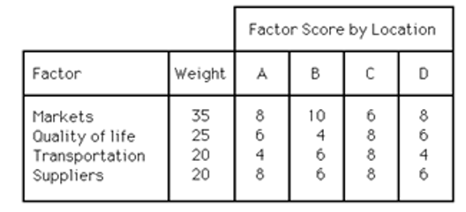
QUALITATIVE FACTOR ANALYSIS METHOD: EXAMPLE
XYZ Restaurant wishes to open a new store. Based on the following subjective criteria, where should the new store be located?
a. A
b. B
c. C
d. D

Slide 26
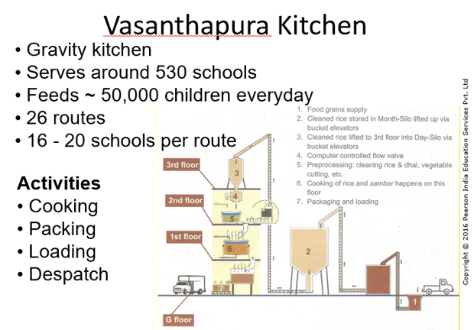

Slide 27
THANK YOU.

