Slide 1


NEW PRODUCT DEVELOPMENT

Slide 2
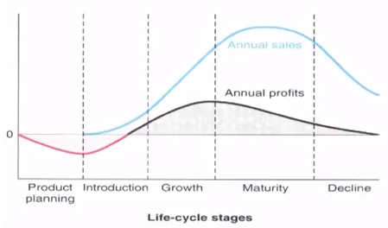
LIFE CYCLE OF PRODUCTS OR SERVICES
Notes:
CUSTOMER DIMENSION
SUATAINED PERFORMANCE
OPERATIONAL ADVANTAGE
STRATEGIC ADVANTAGE

Slide 3
DEFINITION
NEW PRODUCT DEVELOPMENT (NPD) IS THE COMPLETE PROCESS OF BRINGING A NEW PRODUCT OR SERVICE TO MARKET.
NEW PRODUCT DEVELOPMENT MAY BE DONE TO DEVELOP AN ITEM TO COMPETE WITH A PARTICULAR PRODUCT OR MAY BE DONE TO IMPROVE AN ALREADY ESTABLISHED PRODUCT.

Slide 4
NEW PRODUCT CATEGORIES
NEW TO THE WORLD PRODUCTS
NEW PRODUCT LINES
PRODUCT LINE EXTENSIONS
IMPROVEMENTS AND REVISIONS TO EXISTING PRODUCTS
REPOSITIONING
COST REDUCTIONS
Notes:
IPHONE
LOREL
COKE , colour, size
SIZE COLOUR
VITUAL DESIGN PROTOTYPE
Repositioning- hutch-Vodafone, godrej, apple, uti-axis bank.

Slide 5
STAGES IN THE PRODUCT DEVELOPMENT PROCESS
CONCEPT GENERATION: UNDERSTANDING WHAT THE CUSTOMER NEEDS ARE AND TRANSLATING THEM INTO ALTERNATIVE IDEAS FOR PRODUCTS THAT SERVICES THAT CAN BE DEVELOPED
DESIGN: DETAILED SPECIFICATIONS ARE FIRST DRAWN ABOUT THE PRODUCT/SERVICE
DEVELOPMENT: PHYSICAL DEVELOPMENT OF THE PRODUCT; DURING THIS STAGE, THE DETAILS ARRIVED AT THE DRAWING BOARD ARE PHYSICALLY TRANSFERRED TO REALITY AS A PROTOTYPE.
PRODUCTION: REGULAR PRODUCTION IN SMALLER/PILOT QUANTITIES FOLLOWED BY MASS PRODUCTION AS PER MARKET DEMAND

Slide 6
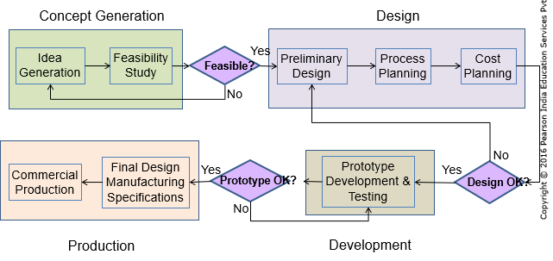
A TYPICAL DEVELOPMENT PROCESS
Notes:
MUSIC
PEN

Slide 7
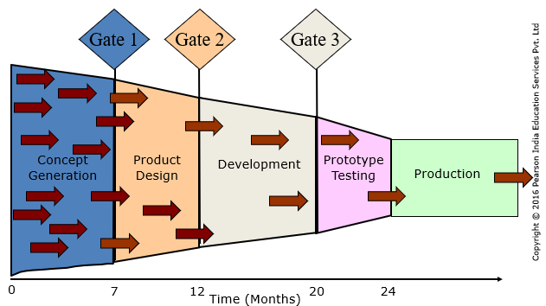
PRODUCT DEVELOPMENT FUNNEL : STAGES - GATES

Slide 8
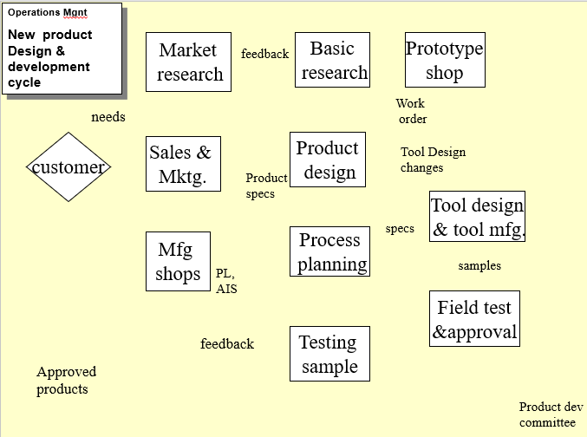
A TYPICAL DEVELOPMENT PROCESS

Slide 9
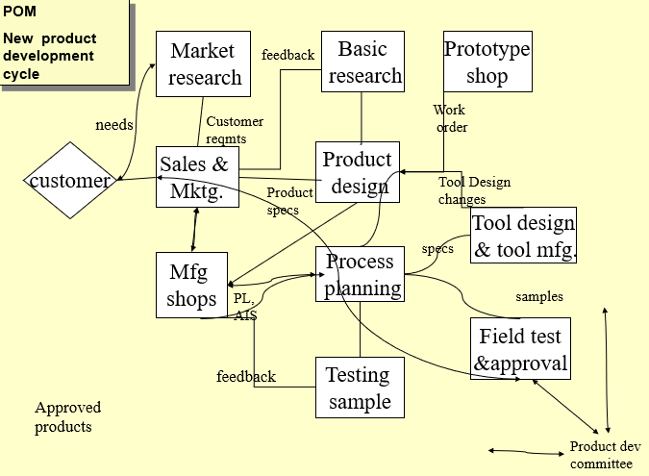
A TYPICAL DEVELOPMENT PROCESS

Slide 10
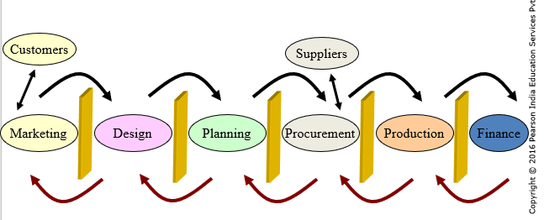
PRODUCT DEVELOPMENT PROCESS: TRADITIONAL APPROACH

Slide 11
NEW PRODUCT DEVELOPMENT : CONCURRENT ENGINEERING
CONCURRENT ENGINEERING CAN BE DEFINED AS THE SIMULTANEOUS DEVELOPMENT OF PRODUCT DESIGN WITH OPEN AND INTERACTIVE COMMUNICATION AMONG ALL TEAM MEMBERS FOR THE PURPOSE OF
REDUCING TIME TO MARKET
DECREASING COST AND IMPROVING QUALITY AND RELIABILITY

Slide 12
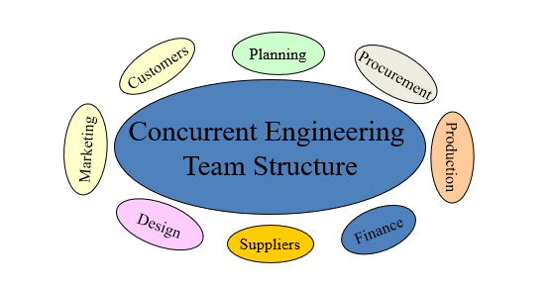
PRODUCT DEVELOPMENT PROCESS: CONCURRENT ENGINEERING

Slide 13
TOOLS FOR EFFICIENT PRODUCT DEVELOPMENT
CUSTOMER NEEDS
MARKET RESEARCH
COMPETITOR ANALYSIS
QUALITY FUNCTION DEPLOYMENT
VALUE ENGINEERING
APPROCHES FOR DESIGN AND DEVELOPMENT
MASS CUSTOMIZATION

Slide 14
VALUE ENGINEERING
VALUE ENGINEERING
REFERS TO A SET OF ACTIVITIES UNDERTAKEN TO INVESTIGATE THE DESIGN OF COMPONENTS IN A PRODUCT DEVELOPMENT PROCESS
STRICTLY FROM A COST – VALUE PERSPECTIVE
TO ALERT THE PRODUCT DEVELOPMENT TEAM TO ALTERNATIVES THAT
COULD EITHER BRING DOWN THE COST OR
INCREASE THE VALUE
BY IMPROVING ON THE FUNCTIONALITIES AND PERFORMANCE WITHOUT INCREASING THE COST

Slide 15
APPROCHES FOR DESIGN AND DEVELOPMENT
DESIGN FOR MANUFACTURING (DFM)
DESIGN FOR ASSEMBLY (DFA)
DESIGN FOR RECYCLING (DFR)
RE-MANUFACTURING
DESIGN FOR DISASSEMBLY (DFD)‏
ROBUST DESIGN

Slide 16
MASS CUSTOMIZATION
STANDARDISATION
USES COMMONLY AVAILABLE PARTS
REDUCES COSTS & INVENTORY
MODULAR DESIGN
COMBINES STANDARDIZED BUILDING BLOCKS/MODULES INTO UNIQUE PRODUCTS
PRODUCT PLATFORMS

Slide 17
REASONS FOR PRODUCT FAILURE
COSTS ARE TOO HIGH
QUALITY IS TOO LOW
INTRODUCTION WAS TOO LATE
PRODUCTION COULDN'T KEEP UP WITH DEMAND.

Slide 18
NEW PRODUCT DEVELOPMENT : STRATEGY
3M DICTATES THAT 30% OF REVENUES WILL COME FROM NEW PRODUCTS EVERY YEAR.
BRITISH AIRWAYS REFRESHES ITS SERVICES CLASSES EVERY FIVE YEARS.
STARBUCKS OPENS 300 STORES PER YEAR.
GILLETTE BRINGS OUT ABOUT 20 PRODUCTS EACH YEAR.

Slide 19
Moore’s Law
Every 18 months processing power doubles while cost holds constant.

Slide 20
OUTSOURCING
MANUFACTURING FIRM DECIDE TO PURCHASE CERTAIN PARTS RATHER THAN MAKE THEM.
SOMETIMES THE FIRM BUY ALL THE PARTS FROM OUTSOURCING.
AND SIMPLY PERFORM ONLY ASSEMBLY OPERATIONS TO PRODUCE THE FINISHED PRODUCTS.
Notes:
LAW FIRM

Slide 21
OFFSHORING
OFFSHORING IS REFERRED TO THE OUTSOURCING OF BUSINESS PROCESSES TO A LOCATION DISTANT FROM THE SERVICE CONSUMERS.
Notes:
DELL SEVICE CENTRE IN INDIA FOR AMERICAN CLIENTS

Slide 22
OFFSHORING VS OUTSOURCING
 | OFFSHORING | OUTSOURCING
DEFINITION | OFFSHORING MEANS GETTING WORK DONE IN A DIFFERENT COUNTRY. | OUTSOURCING REFERS TO CONTRACTING WORK OUT TO AN EXTERNAL ORGANIZATION.
RISKS AND CRITICISM | OFFSHORING IS OFTEN CRITICIZED FOR TRANSFERRING JOBS TO OTHER COUNTRIES. OTHER RISKS INCLUDE GEOPOLITICAL RISK, LANGUAGE DIFFERENCES AND POOR COMMUNICATION ETC. | RISKS OF OUTSOURCING INCLUDE MISALIGNED INTERESTS OF CLIENTS AND VENDORS, INCREASED RELIANCE ON THIRD PARTIES, LACK OF IN-HOUSE KNOWLEDGE OF CRITICAL (THOUGH NOT NECESSARILY CORE) BUSINESS OPERATIONS ETC.
BENEFITS | BENEFITS OF OFFSHORING ARE USUALLY LOWER COSTS, BETTER AVAILABILITY OF SKILLED PEOPLE, AND GETTING WORK DONE FASTER THROUGH A GLOBAL TALENT POOL. | USUALLY COMPANIES OUTSOURCE TO TAKE ADVANTAGE OF SPECIALIZED SKILLS, COST EFFICIENCIES AND LABOR FLEXIBILITY.

Slide 23
FACTORS
AVAILABLE CAPACITY : IF AN ORGANIZATION HAS THE EQUIPMENT, NECESSARY SKILLS AND TIME, PRODUCE OR PERFORM A SERVICE IN-HOUSE. COST WILL MINIMIZE.
EXPERTISE : LACK OF EXPERTISE, BUY IT.
QUALITY CONSIDERATION : SPECIALIZED FIRM CAN OFFER BETTER QUALITY, EITHER ITSELF OR OUTSOURCED. IF CLOSE MONITORING OF QUALITY IS REQUIRED, MAKE IT.
THE NATURE OF DEMAND : HIGH AND STEADY DEMAND, DO THE WORK ITSELF. WIDE FLUCTUATION IN DEMAND OR SMALL ORDERS, OUTSOURCE IT.
COST : COST SAVING CAN BE DONE BY AVOIDING TRANSPORTATION, AVOIDING FIXED COST, ETC.
RISK : OUTSOURCING MAY INVOLVE CERTAIN RISKS. ONE IS LOSS OF CONTROL OVER OPERATIONS. ANOTHER IS THE NEED TO DISCLOSE PROPRIETARY INFORMATION.

Slide 24
WHEN TO MAKE
HIGHER PURCHASE PRICE AS COMPARED TO PRODUCTION COST, IF PRODUCED IN- HOUSE.
ASSURANCE OF TIMELY DELIVERY
AVAILABILITY OF THE REQUIRED FACILITIES AND CAPACITIES IN-HOUSE.
BETTER CONTROL OF QUALITY.
NEED TO PRESERVE TRADE SECRETS AND DESIGN SECRETS.
SAVINGS ON TRANSPORTATION COSTS OF ITEMS FROM VENDOR’S PREMISES TO THE BUYING FIRM.

Slide 25
WHEN TO BUY
WHEN THE PURCHASE PRICE IS LESSER.
DEMAND IS LOW AND DOES NOT JUSTIFY INVESTMENT ON EQUIPMENT, MACHINES AND TOOLS FOR MANUFACTURING.
ABILITY OF THE SUPPLIER TO SUPPLY THE ITEM AT LOWER COST, HIGHER QUALITY AND FASTER DELIVERY.
WHEN THE OUTSIDE SUPPLIERS HOLD A PATENT ON THE NEEDED ITEM.
WHEN THE OPPORTUNITY COST OF PRODUCING IS MUCH HIGHER THAN THAT OF BUYING.
WHEN THERE IS NO PROBLEM OF TRADE SECRETS OR DESIGN SECRETS FOR THE BUYING FIRM.
WHEN THERE IS NOT ENOUGH CAPACITY TO MAKE AN ITEM AND INCREASING THE CAPACITY IS NOT COST EFFECTIVE.
WHEN THERE IS NO LONG TERM REQUIREMENT OF THE ITEM.

Slide 26
THANK YOU.

