Slide 1


QUALITY MANAGEMENT

Slide 2
QUALITY
QUALITY MAY BE DEFINED AS THE SUM TOTAL OF FEATURES OF A PRODUCT WHICH INFLUENCE ITS ABILITY TO SATISFY A GIVEN DEMAND.
THE QUALITY OF PRODUCTS AND SERVICES IS NOT DEFINED OR DETERMINED BY PRODUCING FIRMS, IT IS DETERMINED BY CUSTOMERS.
IT IS CUSTOMER’S PERCEPTION OF THE DEGREE TO WHICH THE PRODUCT OR SERVICE MEETS HIS OR HER EXPECTATIONS.

Slide 3
WHAT IS QUALITY?
DIFFERENT VIEWS/DEFINITIONS
- “THE DEGREE OF EXCELLENCE OF A THING”
- “FITNESS FOR USE”
- “ABILITY OF THE PRODUCT TO CONSISTENTLY MEET OR EXCEED CUSTOMER EXPECTATIONS.”

Slide 4
INSPECTION
THE ACT OF DETERMINING CONFORMANCE OR NON-CONFORMANCE OF THE EXPECTED PERFORMANCE IS THE FUNCTION OF INSPECTION.

Slide 5
THREE LEVELS OF QUALITY
ORGANIZATION LEVEL – MEETING EXTERNAL CUSTOMER REQUIREMENTS
PROCESS LEVEL – MEETING THE NEEDS OF INTERNAL CUSTOMERS
PERFORMER LEVEL (JOB LEVEL OR TASK DESIGN LEVEL) – MEETING THE REQUIREMENTS
OF ACCURACY,COMPLETENESS,
INNOVATION,TIMELINESS AND
COST.
STAGES OF QUALITY MANAGEMENT :
- INSPECTION
- QUALITY CONTROL
- QUALITY ASSURANCE

Slide 6
INSPECTION AND QUALITY CONTROL
INSPECTION IS A COMPARISON WITH ESTABLISHED STANDARDS. IT IS A POST-MORTEM OPERATION CARRIED OUT AFTER THE PRODUCT IS MANUFACTURED.
QUALITY CONTROL IS CONCERNED WITH ANY FUNCTION WHICH CONTRIBUTES TO THE QUALITY OF GOODS PRODUCED.

Slide 7
WHAT IS QUALITY CONTROL?
SETTING QUALITY STANDARDS (OBJECTIVES OR TARGETS)
APPRAISAL OF CONFORMANCE (QUALITY MEASUREMENT)
TAKING CORRECTIVE ACTIONS TO REDUCE DEVIATIONS
PLANNING FOR QUALITY IMPROVEMENT

Slide 8
QUALITY GURUS
WILLAM EDWARDS DEMING
JOSEPH M JURAN
MANY MORE…

Slide 9
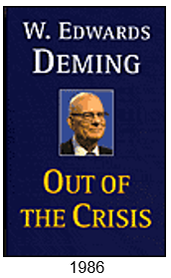
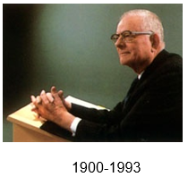
THE QUALITY GURUS – EDWARD DEMING
QUALITY IS “UNIFORMITY AND DEPENDABILITY”
FOCUS ON SPC AND STATISTICAL TOOLS
“14 POINTS” FOR MANAGEMENT
PDCA METHOD

Slide 10
DEMING’S CONTRIBUTIONS
NEW PERCEPTIONS TO QUALITY MANAGEMENT
PLAN – DO – CHECK – ACT (PDCA) CYCLE
14 POINT AGENDA FOR QUALITY IMPROVEMENT
CONSIDERED FATHER OF JAPANESE QUALITY MANAGEMENT SYSTEMS
HIGHEST AWARD IN JAPAN NAMED AFTER HIM

Slide 11
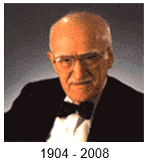

THE QUALITY GURUS – JOSEPH JURAN
QUALITY IS “FITNESS FOR USE”
PARETO PRINCIPLE
COST OF QUALITY
GENERAL MANAGEMENT APPROACH AS WELL AS STATISTICS.

Slide 12
JURAN’S QUALITY TRILOGY
JURAN’S TRILOGY
QUALITY PLANNING: THE PROCESS OF PREPARING TO MEET QUALITY GOALS
QUALITY CONTROL: THE PROCESS OF MAKING QUALITY GOALS DURING OPERATIONS
QUALITY IMPROVEMENT: THE PROCESS OF BREAKING THROUGH TO UNPRECEDENTED LEVELS OF PERFORMANCE
JURAN’S QUALITY IMPROVEMENT PLAN
1) ESTABLISH SPECIFIC GOALS
2) ESTABLISH PLANS FOR THE ABOVE
3) ASSIGN CLEAR RESPONSIBILITIES
4) BASE REWARDS ON RESULTS

Slide 13
QUALITY AND PRODUCTIVITY
PRODUCTIVITY = OUTPUT / INPUT
FEWER DEFECTS INCREASE OUTPUT
QUALITY IMPROVEMENT REDUCES INPUTS

Slide 14
DIMENSIONS OF PRODUCT QUALITY
PERFORMANCE : HOW WILL THE PRODUCT OR SERVICE PERFORM AND MEET THE CUSTOMER’S INTENDED USE. EX, THE SPEED OF THE SPORTS CAR.
FEATURES : THE SPECIAL CHARACTERISTICS THAT APPEAL TO CUSTOMERS. FOR EX, THE POWER STEERING OF AN AUTOMOBILE
RELIABILITY : THE LIKELIHOOD OF BREAKDOWNS, MALFUNCTIONS, OR NEED FOR REPAIRS. HIGHER THE RELIABILITY LESSER WILL BE THE LIKELIHOOD OF BREAKDOWNS AND MALFUNCTIONS AND BETTER WILL BE THE QUALITY OF THE PRODUCT.
SERVICEABILITY : THE SPEED, COST AND CONVENIENCE OF REPAIRS AND MAINTENANCE. HIGHER THE SERVICEABILITY BETTER WILL BE THE QUALITY OF THE PRODUCT.

Slide 15
DIMENSIONS OF PRODUCT QUALITY
APPEARANCE : THE EFFECT OR HUMAN SENSES, THE LOOK, FEEL, TASTE, SMELL OR SOUND.
CUSTOMER SERVICE : THE TREATMENT RECEIVED BY CUSTOMERS BEFORE, DURING AND AFTER THE SALE.
SAFETY : HOW WELL THE PRODUCT PROTECTS USERS BEFORE DURING AND AFTER USE.

Slide 16
SERVICE QUALITY- DIMENSIONS
TIME & TIMELINESS - CUSTOMER WAITING TIME, COMPLETED ON TIME
COMPLETENESS - CUSTOMER GETS ALL THEY ASKED FOR
COURTESY - TREATMENT BY EMPLOYEES
CONSISTENCY - SAME LEVEL OF SERVICE FOR ALL CUSTOMERS
ACCESSIBILITY & CONVENIENCE - EASE OF OBTAINING SERVICE
ACCURACY - PERFORMED RIGHT EVERY TIME
RESPONSIVENESS - REACTIONS TO UNUSUAL SITUATIONS

Slide 17
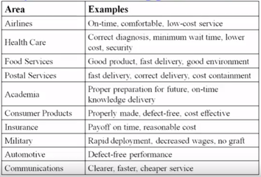
QUALITY IN DIFFERENT APPLICATIONS

Slide 18
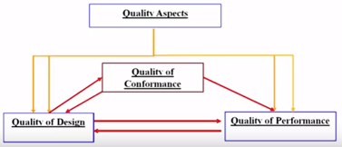
THREE ASPECTS OF QUALITY

Slide 19
COSTS ASSOCIATED WITH QUALITY MANAGEMENT
PREVENTION COSTS
APPRAISAL COSTS
INTERNAL FAILURE COSTS
EXTERNAL FAILURE COSTS

Slide 20
PREVENTION COSTS
COSTS ASSOCIATED WITH PREVENTING DEFECTS BEFORE THEY HAPPEN.
EXAMPLE- COSTS OF PROCESS DESIGN, PRODUCT AND SERVICE DESIGN, EMPLOYEE TRAINING, SUPPLIER PROGRAMS, ETC.
AS QUALITY INCREASES THIS COST INCREASE.

Slide 21
APPRAISAL COSTS
COSTS INCURRED IN ASSESSING THE LEVEL OF QUALITY.
EXAMPLE - COSTS OF INSPECTION, TESTING.
AS QUALITY INCREASES THIS COST DECREASE.

Slide 22
INTERNAL FAILURE COSTS
INTERNAL FAILURES ARE THOSE THAT ARE DISCOVERED DURING THE PRODUCTION PROCESS.
EXAMPLE - COST OF REWORKING.
AS QUALITY INCREASES THIS COST DECREASE.

Slide 23
EXTERNAL FAILURE COSTS
EXTERNAL FAILURES ARE THOSE THAT ARE DISCOVERED AFTER DELIVERY TO THE CUSTOMER.
EXAMPLE - WARRANTY COSTS, LOSS OF MARKET SHARE, LAWSUITS FROM INJURY.
AS QUALITY INCREASES THIS COST DECREASE.

Slide 24
SEVEN QUALITY CONTROL TOOLS
PROF. KAROU ISHIKAWA DEVELOPED THE SEVEN QC TOOLS.
BASED ON HIS EXPERIENCE, HE IDENTIFIED A SET OF TOOLS, WHICH CAN BE USED BY TEAMS AND INDIVIDUALS TO INTERPRET DATA AND DERIVE MAXIMUM INFORMATION FROM IT.
THESE ARE SEVEN EFFECTIVE METHODS, WHICH CAN OFFER ANY ORGANIZATION THE MEANS TO COLLECT, PRESENT AND ANALYZE MOST OF ITS DATA AND PROBLEMS.

Slide 25
SEVEN QUALITY CONTROL TOOLS
PARETO ANALYSIS
ISHIKAWA DIAGRAM OR FISHBONE DIAGRAM
CHECK SHEET
CONTROL CHARTS
HISTOGRAM
SCATTER PLOT
STRATIFICATION

Slide 26
PARETO ANALYSIS
A TECHNIQUE USED FOR DECISION MAKING BASED ON THE PARETO PRINCIPLE, KNOWN AS THE 80/20 RULE.
PARETO ANALYSIS IS BASED ON THE IDEA THAT 80% OF A PROJECT'S BENEFIT CAN BE ACHIEVED BY DOING 20% OF THE WORK OR CONVERSELY 80% OF PROBLEMS ARE TRACED TO 20% OF THE CAUSES.

Slide 27
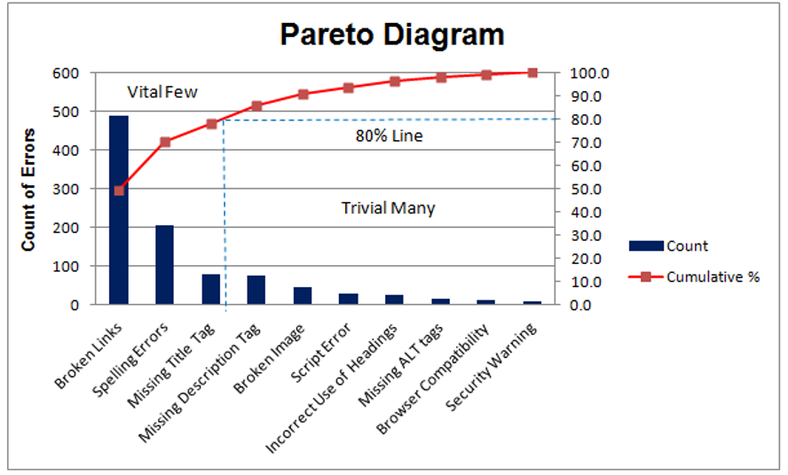
PARETO ANALYSIS

Slide 28
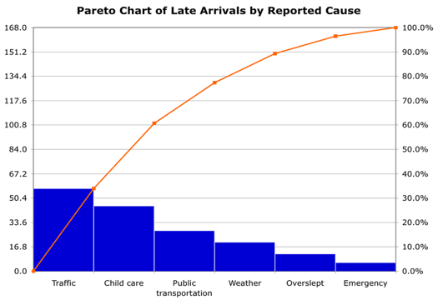
PARETO ANALYSIS

Slide 29
PARETO ANALYSIS
THE LEFT VERTICAL AXIS IS THE FREQUENCY OF OCCURRENCE, BUT IT CAN ALTERNATIVELY REPRESENT COST OR ANOTHER IMPORTANT UNIT OF MEASURE.
THE RIGHT VERTICAL AXIS IS THE CUMULATIVE PERCENTAGE OF THE TOTAL NUMBER OF OCCURRENCES, TOTAL COST, OR TOTAL OF THE PARTICULAR UNIT OF MEASURE.
TO TAKE THE EXAMPLE ABOVE, IN ORDER TO LOWER THE AMOUNT OF LATE ARRIVING BY 78%, IT IS SUFFICIENT TO SOLVE THE FIRST THREE ISSUES.

Slide 30
ISHIKAWA DIAGRAMS (ALSO CALLED FISHBONE ,CAUSE AND EFFECT DIG)
ISHIKAWA DIAGRAMS (ALSO CALLED FISHBONE DIAGRAMS, ARE CAUSAL DIAGRAMS CREATED BY KAROU ISHIKAWA (1968) THAT SHOW THE CAUSES OF A SPECIFIC EVENT.
EACH CAUSE OR REASON FOR IMPERFECTION IS A SOURCE OF VARIATION. CAUSES ARE USUALLY GROUPED INTO MAJOR CATEGORIES TO IDENTIFY THESE SOURCES OF VARIATION.

Slide 31
THE CATEGORIES TYPICALLY INCLUDE:
PEOPLE
METHODS
MACHINES
MATERIALS
MEASUREMENTS
ENVIRONMENT

Slide 32
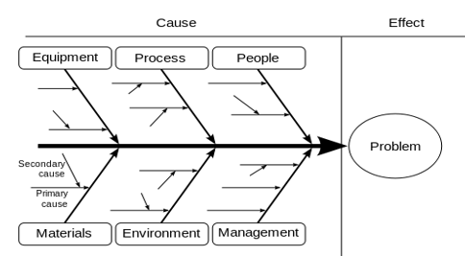
Purpose
To break down (in successive layers of detail) root causes that potentially contribute to a particular effect

Slide 33
Quality improvement Method
Cause & Effect Diagram(Fish bone diagram)
Inspection CPU Chip
Pins not
Assigned
Received
Defective
Classification
Error
Defective
Pins
Damaged
in storage
Defective Computer
CPU
Condition
Procedures
and Methods
Maintenance
Speed
Training
Equipment
Employees

Slide 34
Fishbone diagram analysis - Example
Absent receiving party
Working system of operators
Absent
Too many phone calls
Out of office
Lunchtime
Makes customer wait
Not at desk
Absent
Not giving receiving party’s coordinates
Does not understand customer
Lengthy talk
Complaining
Does not know organization well
Leaving a message
Takes too much time to explain
Customer
Operator

Slide 35
CHECK SHEET
THE CHECK SHEET IS A FORM USED TO COLLECT DATA IN REAL TIME AT THE LOCATION WHERE THE DATA ARE GENERATED.
THE DEFINING CHARACTERISTIC OF A CHECK SHEET IS THAT DATA ARE RECORDED BY MAKING MARKS OR CHECKS ON IT.

Slide 36
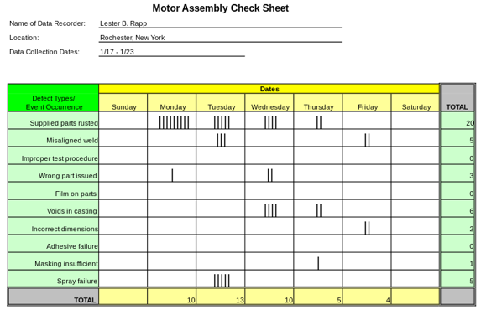
PURPOSE - TO PROVIDE A STRUCTURED WAY TO COLLECT QUALITY-RELATED DATA AS A ROUGH MEANS FOR ASSESSING A PROCESS OR AS AN INPUT TO OTHER ANALYSES

Slide 37
CONTROL CHARTS
CONTROL CHART IS ALSO KNOWN AS SHEWHART CHARTS (AFTER WALTER A. SHEWHART) OR PROCESS- BEHAVIOR CHARTS.
IT IS USED TO DETERMINE IF A MANUFACTURING OR BUSINESS PROCESS IS IN A STATE OF STATISTICAL CONTROL.

Slide 38
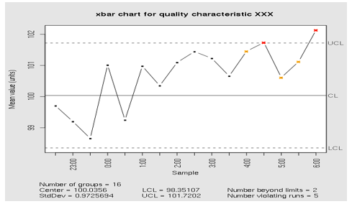
Purpose
To determine whether a process should undergo a formal examination for quality-related problem

Slide 39
HISTOGRAM
A HISTOGRAM IS A GRAPHIC SUMMARY OF VARIATION IN A SET OF DATA.
IT ENABLES US TO SEE PATTERNS THAT ARE DIFFICULT TO SEE IN A SIMPLE TABLE OF NUMBERS.
A HISTOGRAM IS A GRAPH IN WHICH THE CONTINUOUS VARIABLE IS CLUSTERED INTO CATEGORIES AND THE VALUE OF EACH CLUSTER IS PLOTTED TO GIVE A SERIES OF BARS.

Slide 40
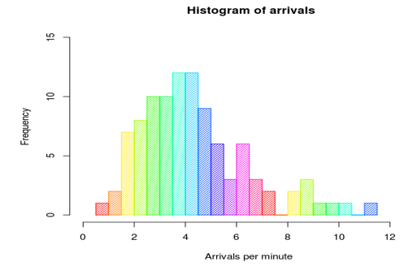
HISTOGRAM

Slide 41
SCATTER PLOT
A SCATTER PLOT OR SCATTER GRAPH IS A TYPE OF MATHEMATICAL DIAGRAM USING CARTESIAN COORDINATES TO DISPLAY VALUES FOR TWO VARIABLES FOR A SET OF DATA.
THE DATA IS DISPLAYED AS A COLLECTION OF POINTS, EACH HAVING THE VALUE OF ONE VARIABLE DETERMINING THE POSITION ON THE HORIZONTAL AXIS AND THE VALUE OF THE OTHER VARIABLE DETERMINING THE POSITION ON THE VERTICAL AXIS.

Slide 42
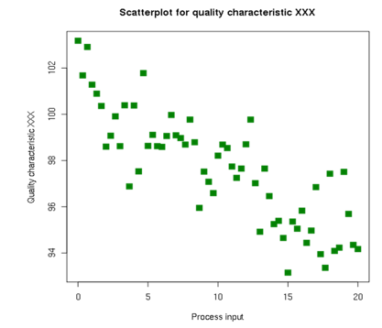
SCATTER PLOT
PURPOSE - TO IDENTIFY THE TYPE OF RELATIONSHIP (IF ANY) BETWEEN TWO VARIABLES

Slide 43
STRATIFICATION
STRATIFICATION IS STRATIFYING OR CATEGORIZING OF DATA IN SOME MEANINGFUL CATEGORIES. CATEGORIES CAN BE DETERMINED BY EQUIPMENT, OR OPERATOR, BY OPERATION METHOD OR BY RAW MATERIAL.
GROUPING OF DATA BY COMMON ELEMENT OR CHARACTERISTICS MAKES IT EASIER TO UNDERSTAND THE DATA AND TO PULL INSIGHTS FROM IT.
USING STRATIFICATION ONE CAN ARRIVE AT ROOT CAUSE. PROBLEM WILL BE SOLVED ONLY WHEN ROOT CAUSE WILL BE SOLVED.
EG- SOCIAL STRATIFICATION

Slide 44
THANK YOU.

