Slide 1



SIX SIGMA

Slide 2
SIX SIGMA
THE TERM “SIX SIGMA” WAS COINED BY BILL SMITH, AN ENGINEER WITH MOTOROLA
LATE 1970S - MOTOROLA STARTED EXPERIMENTING WITH PROBLEM SOLVING THROUGH STATISTICAL ANALYSIS
1987 - MOTOROLA OFFICIALLY LAUNCHED IT’S SIX SIGMA PROGRAM

Slide 3
SIX SIGMA
“A DISCIPLINED METHOD OF USING EXTREMELY RIGOROUS DATA GATHERING AND STATISTICAL ANALYSIS TO PINPOINT SOURCES OF ERRORS AND WAYS OF ELIMINATING THEM"
-HARRY SCHROEDER,2000

Slide 4
WHAT IS SIGMA ?
A TERM (GREEK) USED IN STATISTICS TO REPRESENT STANDARD DEVIATION FROM MEAN VALUE, AN INDICATOR OF THE DEGREE OF VARIATION IN A SET OF A PROCESS.
SIGMA MEASURES HOW FAR A GIVEN PROCESS DEVIATES FROM PERFECTION. HIGHER SIGMA CAPABILITY, BETTER PERFORMANCE.

Slide 5
WHAT IS SIX SIGMA?
SIX SIGMA - A HIGHLY DISCIPLINED PROCESS THAT ENABLES ORGANIZATIONS DELIVER NEARLY PERFECT PRODUCTS AND SERVICES.
THE FIGURE OF SIX ARRIVED STATISTICALLY FROM CURRENT AVERAGE MATURITY OF MOST BUSINESS ENTERPRISES
A PHILOSOPHY AND A GOAL: AS PERFECT AS PRACTICALLY POSSIBLE.
A METHODOLOGY AND A SYMBOL OF QUALITY.

Slide 6
WHAT IS SIX SIGMA?
A STATISTICAL CONCEPT THAT MEASURES A PROCESS IN TERMS OF DEFECTS – AT THE SIX SIGMA LEVEL, THERE 3.4 DEFECTS PER MILLION OPPORTUNITIES.

Slide 7
WHAT IS SIX SIGMA
SIX SIGMA IS NOT
A STANDARD
A CERTIFICATION
ANOTHER METRIC LIKE PERCENTAGE
RATHER!
IT IS A QUALITY PHILOSOPHY AND THE WAY OF IMPROVING PERFORMANCE BY KNOWING WHERE YOU ARE AND WHERE YOU COULD BE.
METHODOLOGY TO MEASURE AND IMPROVE COMPANY’S PERFORMANCE, PRACTICES AND SYSTEMS

Slide 8
WHAT IS SIX SIGMA
SIX SIGMA EMERGED AS A NATURAL EVOLUTION IN BUSINESS TO INCREASE PROFIT BY ELIMINATING DEFECTS.
THE CURRENT BUSINESS ENVIRONMENT NOW DEMANDS AND REWARDS INNOVATION MORE THAN EVER BEFORE DUE TO:
CUSTOMER EXPECTATIONS
TECHNOLOGICAL CHANGE
GLOBAL COMPETITION
MARKET FRAGMENTATION

Slide 9
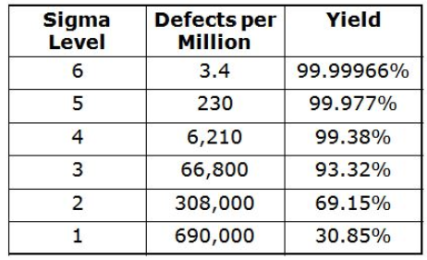

Slide 10
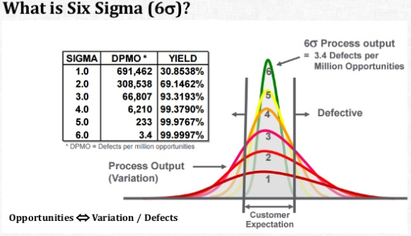

Slide 11

COMPANIES USING SIX SIGMA
SIX SIGMA IS IN USE IN VIRTUALLY ALL INDUSTRIES AROUND THE WORLD. SOME OF COMPANIES CAN BE LISTED AS:
MOTOROLA
ERICSSON
GENERAL ELECTRIC
SONY
FORD MOTOR CO.
CITI BANK

Slide 12
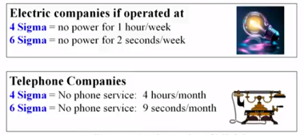
SIX SIGMA

Slide 13
SIX SIGMA METHODOLOGY
IT TAKES MONEY TO SAVE MONEY
BPMS
BUSINESS PROCESS MANAGEMENT SYSTEM
DMAIC
SIX SIGMA IMPROVEMENT METHODOLOGY
DMADV
CREATING NEW PROCESS WHICH WILL PERFORM AT SIX SIGMA

Slide 14
BUSINESS PROCESS MANAGEMENT SYSTEM
BPM STRATEGIES EMPHASIZE ON PROCESS IMPROVEMENT AND AUTOMATION TO DERIVE PERFORMANCE.
COMBINING BPM STRATEGIES WITH SIGMA SIX IS MOST POWERFUL WAY TO IMPROVE PERFORMANCE.
BOTH STRATEGIES ARE NOT MUTUALLY EXCLUSIVE BUT SOME COMPANIES PRODUCED DRAMATIC RESULTS BY COMBINING THEM.

Slide 15
METHODS
SIX SIGMA PROJECTS FOLLOW PROJECT METHODOLOGIES INSPIRED BY DEMING'S PLAN-DO-CHECK-ACT CYCLE.
THESE METHODOLOGIES, COMPOSED OF FIVE PHASES EACH, BEAR THE ACRONYMS DMAIC AND DMADV.
DMAIC IS USED FOR PROJECTS AIMED AT IMPROVING AN EXISTING BUSINESS PROCESS.
DMADV IS USED FOR PROJECTS AIMED AT CREATING NEW PRODUCT OR PROCESS DESIGNS.

Slide 16
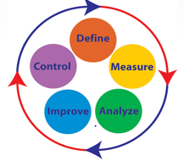
WHAT IS DMAIC?(DEFINE, MEASURE, ANALYZE, IMPROVE, CONTROL)
A LOGICAL AND STRUCTURED APPROACH TO PROBLEM SOLVING AND PROCESS IMPROVEMENT.
AN ITERATIVE PROCESS (CONTINUOUS IMPROVEMENT)
A QUALITY TOOL WHICH FOCUS ON CHANGE MANAGEMENT STYLE.

Slide 17
THE DMAIC PROJECT METHODOLOGY HAS FIVE PHASES
DEFINE THE PROBLEM, THE VOICE OF THE CUSTOMER, AND THE PROJECT GOALS, SPECIFICALLY.
MEASURE KEY ASPECTS OF THE CURRENT PROCESS AND COLLECT RELEVANT DATA.
ANALYZE THE DATA TO INVESTIGATE AND VERIFY CAUSE-AND-EFFECT RELATIONSHIPS. DETERMINE WHAT THE RELATIONSHIPS ARE, AND ATTEMPT TO ENSURE THAT ALL FACTORS HAVE BEEN CONSIDERED. SEEK OUT ROOT CAUSE OF THE DEFECT UNDER INVESTIGATION.

Slide 18
THE DMAIC PROJECT METHODOLOGY HAS FIVE PHASES
IMPROVE OR OPTIMIZE THE CURRENT PROCESS BASED UPON DATA ANALYSIS USING TECHNIQUES SUCH AS DESIGN OF EXPERIMENTS, POKAYOKE OR MISTAKE PROOFING, AND STANDARD WORK TO CREATE A NEW, FUTURE STATE PROCESS. SET UP PILOT RUNS TO ESTABLISH PROCESS CAPABILITY.
CONTROL THE FUTURE STATE PROCESS TO ENSURE THAT ANY DEVIATIONS FROM TARGET ARE CORRECTED BEFORE THEY RESULT IN DEFECTS. IMPLEMENT CONTROL SYSTEMS SUCH AS STATISTICAL PROCESS CONTROL, PRODUCTION BOARDS, VISUAL WORKPLACES, AND CONTINUOUSLY MONITOR THE PROCESS.
SOME ORGANIZATIONS ADD A RECOGNIZE STEP AT THE BEGINNING, WHICH IS TO RECOGNIZE THE RIGHT PROBLEM TO WORK ON, THUS YIELDING AN RDMAIC METHODOLOGY.

Slide 19
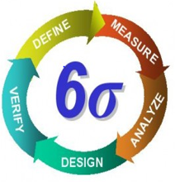
WHAT IS DMADV?
ACRONYM FOR:
DEFINE THE PROJECT
MEASURE THE OPPORTUNITY
ANALYZE THE PROCESS OPTIONS
DESIGN THE PROCESS
VERIFY THE PERFORMANCE

Slide 20
DMADV
THE DMADV PROJECT METHODOLOGY, KNOWN AS DFSS ("DESIGN FOR SIX SIGMA"), FEATURES FIVE PHASES:
DEFINE DESIGN GOALS THAT ARE CONSISTENT WITH CUSTOMER DEMANDS AND THE ENTERPRISE STRATEGY.
MEASURE AND IDENTIFY CTQS (CHARACTERISTICS THAT ARE CRITICAL TO QUALITY), PRODUCT CAPABILITIES, PRODUCTION PROCESS CAPABILITY, AND RISKS.
ANALYZE TO DEVELOP AND DESIGN ALTERNATIVES.
DESIGN AN IMPROVED ALTERNATIVE, BEST SUITED PER ANALYSIS IN THE PREVIOUS STEP.
VERIFY THE DESIGN, SET UP PILOT RUNS, IMPLEMENT THE PRODUCTION PROCESS AND HAND IT OVER TO THE PROCESS OWNER(S).

Slide 21
WHEN SHOULD SIX SIGMA BE USED ?
ITS USAGE DEPENDS ON THE TYPE OF BUSINESS. IN GENERAL,
“IF THERE ARE PROCESSES THAT GENERATE A LOT OF NEGATIVE CUSTOMER FEEDBACK, WHETHER THAT CUSTOMER IS INTERNAL OR EXTERNAL, THE COMPONENTS OF SIX SIGMA SHOULD BE CONSIDERED AS A MEANS TO STUDY AND RECTIFY THE PROBLEM.”

Slide 22
BENEFITS OF SIX SIGMA
GENERATES SUSTAINED SUCCESS
SETS PERFORMANCE GOAL FOR EVERYONE
ENHANCES VALUE FOR CUSTOMERS
ACCELERATES RATE OF IMPROVEMENT
PROMOTES LEARNING ACROSS BOUNDARIES
EXECUTES STRATEGIC CHANGE

Slide 23

SIX SIGMA

Slide 24
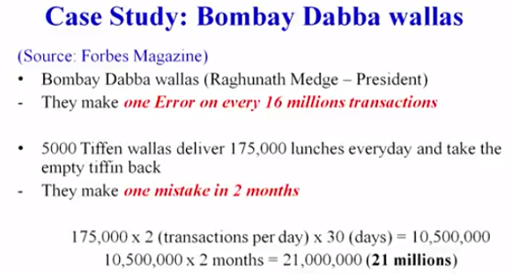
SIX SIGMA

Slide 25
THANK YOU.

