Slide 1
Artificial Intelligence
Prof. Kalpana S Kumaran, HOD
PGDM Digital Marketing & Transformation
ITM Business School
Navi Mumbai

Slide 2
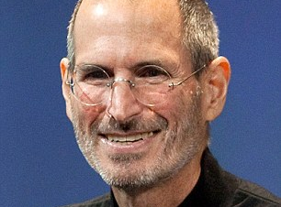
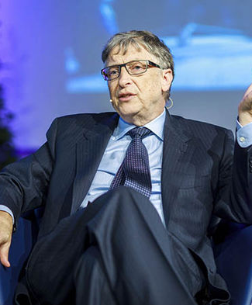


Slide 3




Slide 4
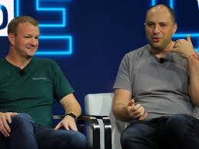

Slide 5

6-year-old made $11 million in one year reviewing toys on You Tube between June 1, 2016, and June 1, 2017
World’s 10 highest-paid YouTube stars earned $127 million, up 80 percent from last year
Highest paid YouTube entrepreneurs
Toys he reviews are sent to him by sponsors. His video descriptions include dozens of links to brand items.
https://www.washingtonpost.com/news/morning-mix/wp/2017/12/11/6-year-old-made-11-million-in-one-year-reviewing-toys-on-you-tube/?noredirect=on&utm-term=&utm_term=.3fbc218b5604

Slide 6
https://www.youtube.com/watch?v=jjd-BeTX6U0

Slide 7

Companies………. to watch
Google
Amazon/Flipcart
Facebook / Whatsapp
OLA/UBER
Swiggy
Trivago
Zomatto
Makemytrip
FreshBasket
Groceries
Paytm, PhonePe, Paypal
Digital Banks

Slide 8
Information Technology Trends ….. to Watch
E-Commerce
Social Media
Artificial Intelligence
Machine Learning
Cloud Computing
Business Analytics
Block Chain
Big Data Analytics
M-Commerce

Slide 9
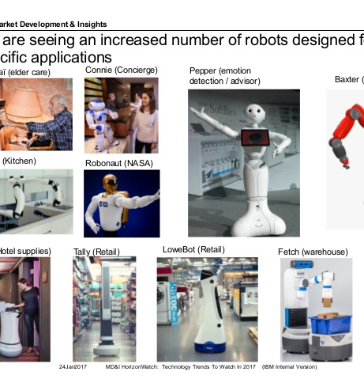
Information Technology Trends ……..to Watch
Internet of Things
Chatbots
Driverless Vehicles
Mobile Devices
GPS
Google Map
Virtual Reality
Augmented Reality

Slide 10
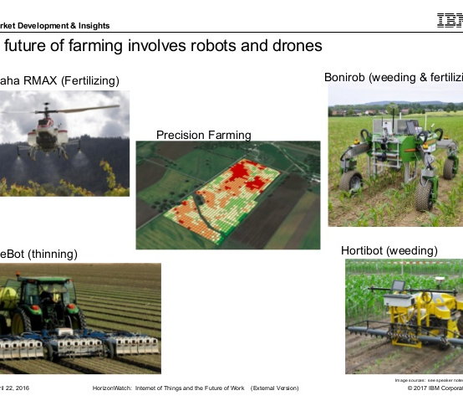
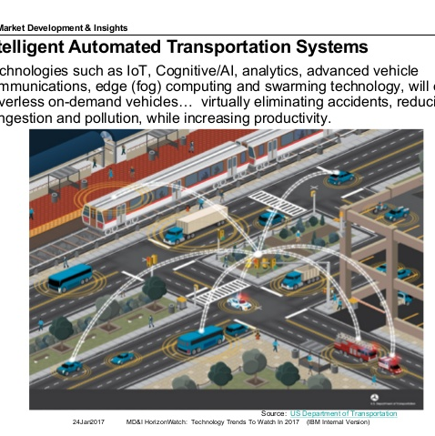
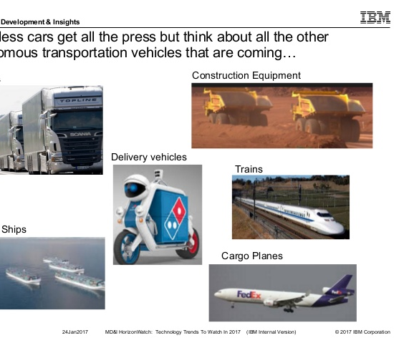
Information Technology Trends …….. to Watch
Robotics
Drones
Sensors
RFID
Intelligent Automated Transportation Systems
Autonomous Transportation Vehicles

Slide 11
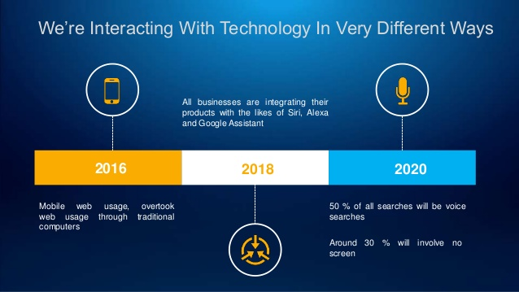

Slide 12
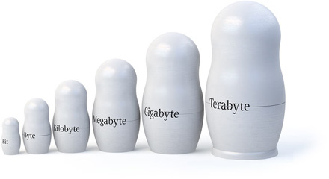
Data Generation
8 Bits = 1 Byte
1024 Byte = 1 Kilobyte
1024 Kilobyte = 1 Megabyte
1024 Megabyte = 1 Gigabyte
1024 Gigabyte = 1 Terabyte
1024 Terabyte = 1 Petabyte
1024 Petabyte = 1 Exabyte
1024 Exabyte = 1 Zettabyte
1024 Zettabyte = 1 Yottabyte
1024 Yottabyte = 1 Brontobyte
1024 Brontobyte = 1 Geopbyte
Bronto Byte = 1 followed by 27 zeros

Slide 13
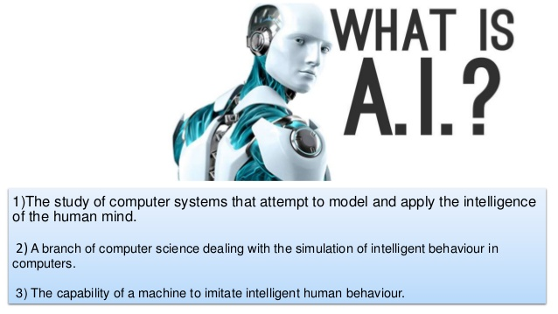
Artificial Intelligence

Slide 14
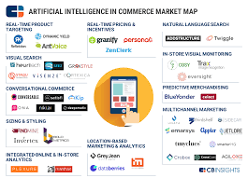
AI Technologies
Machine Learning
Deep Learning
Natural Language Generation
How it can be used to automate our tasks and to enhance the quality of our lives

Slide 15

Role of AI
spam filters.
smart email categorisation.
voice to text features.
smart personal assistants, such as Siri, Cortana and Google Now.
automated responders and online customer support.
process automation.
sales and business forecasting.
security surveillance.

Slide 16
Role of AI
Market Basket Analytics
Customer Analytics
Customer Segmentation/Clustering
Tailored Product Assortments
Inventory Forecasting
Collaborative Filtering Recommender System
Credit Card Analytics

Slide 17

Role of AI
Alcohol Vs. Kids Diaper
Tea Kettle Vs. Tea Strainer
Desert Ride vs. Snakes
Interviewer Vs. Terrorist
Teenager Vs. Pregnancy

Slide 18
Role of AI
Costco Helps Customer Loyalty with Fast Warnings (Listeria Contamination in stone fruits)
Walgreens partnership with Weather Channel - #haircast
Local Pizza Chain - getting a 20% response rate through the combination of a location-based text marketing campaign coupled with cold weather
US Economy Chain Red Roof Inn’s marketing team did a promotional campaign - A (Red) Roof Over Your Head - big data correlating weather conditions/flight cancellations/many travellers would be browsing on mobile devices for staying details

Slide 19

Role of AI
Related Keywords
Ad Word
Ad Sense
Doggy.com Vs. Pedigree
Win-Win

Slide 20
Role of AI
Lowe’s LoweBot
STARBUCKS - My Starbucks Barista
Under Armour & IBM Watson Partnership
Sephora’s Visual Artist
ASOS Image Recognition

Slide 21
AI in Future
In 2025, the AI market is headed to surpass $100 billion.
As per Gartner’s report in 2020, 85% of customer interactions will be managed without human (chatbots or customer digital assistants)

Slide 22

Need of Digital Skills
In 2020 the total digital data is expected to reach 44 Zetta Bytes.
McKinsey forecasts that 2.5 million more managers with digital skills will be required by 2020
KPMG found that 36% of executives admitted that they lack big data specialists

Slide 23
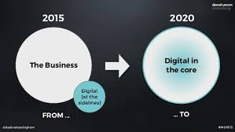
Need of Digital Skills
More than 4.4 million jobs in digital area will be created globally.
The UK will create 56,000 big data jobs a year until 2020, according to business analytics group SAS.
Supply of qualified and trained digital analysts will fall short by 66%.

Slide 24
Need of Digital Transformation Skills
The best career choice.
A student having knowledge in all 4
Business
+
Marketing
+
Technology
+
Analytics
=
PGDM – Digital Marketing & Transformation

Slide 25

Let’s do an activity to understand AI

